Slide 1
DVS LABEL
Janani P
26-Apr-22

Slide 2
PTI| DVS Label
SOP is about how to take Station Label print, its used by shopfloor members. This application is developed by TAIPEI IT team
APPLICATION WITH LINKS:
1. NETFrame 2
Link : http://ptw-sfislb-v01/SFIS-LABEL/Microsoft.NETFramework2.exe
2. NETFrame 4.5
Link : http://ptw-sfislb-v01/SFIS-LABEL/NET4.5.2_NDP452-KB2901907-x86-x64-AllOS-ENU.exe
3. PrintActiveXSetup
Available in Share Folder

Slide 3
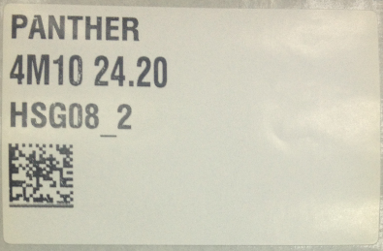
PTI| DVS Label
SAMPLE LABEL :
Below Label is used in Shop Floor in all the lines for certain stations by few departments.

Slide 4
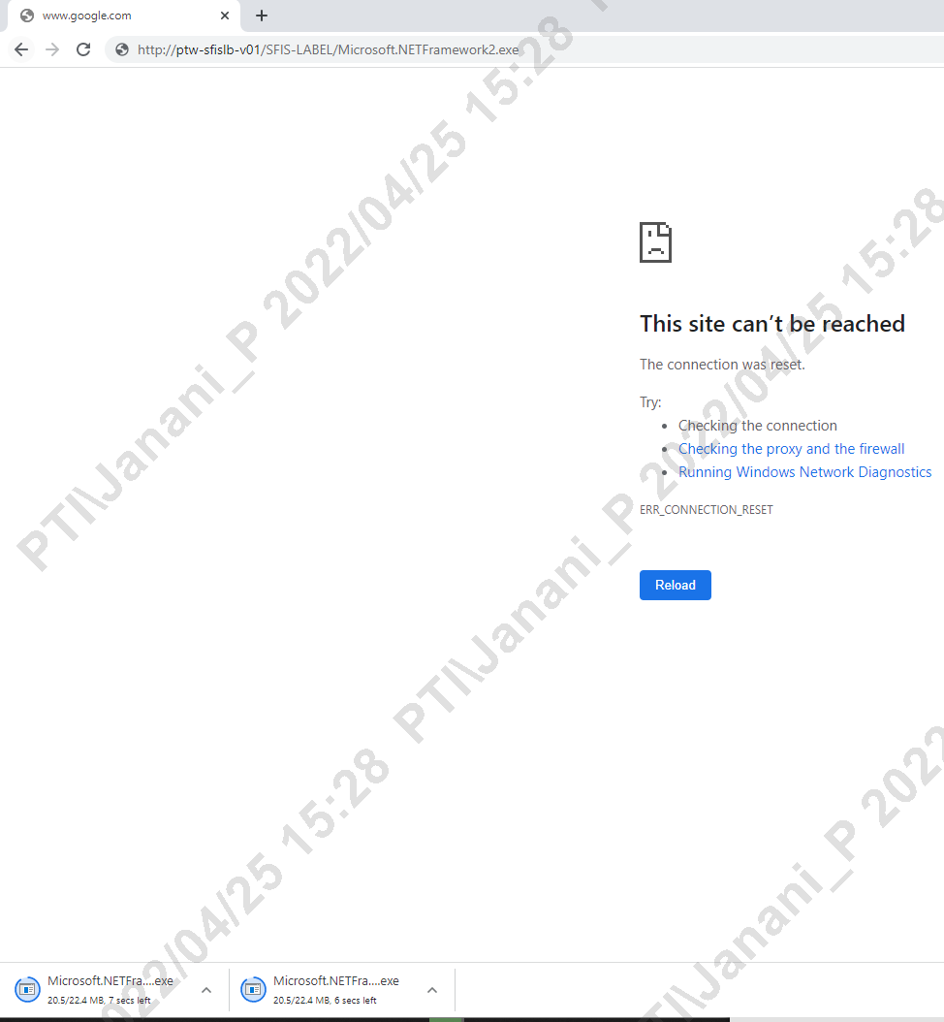
PTI| DVS Label
SFIS RESPONSIBILITIES :
Need To install applications and clear errors that occurs while taking label Print
STEP: 1 Need To Install 2 Applications
* Applications will be available in Share folder, if not so can download based on the link shared in slide 2
* Paste the link in IE Browser and download the application, Just by opening with OA login the app gets installed

Slide 5
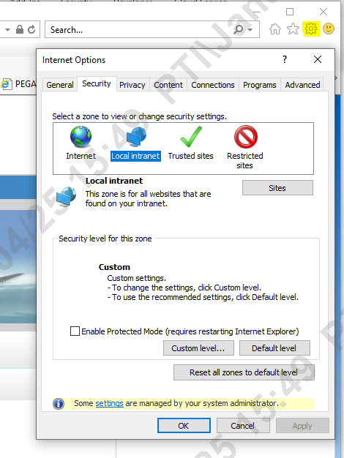
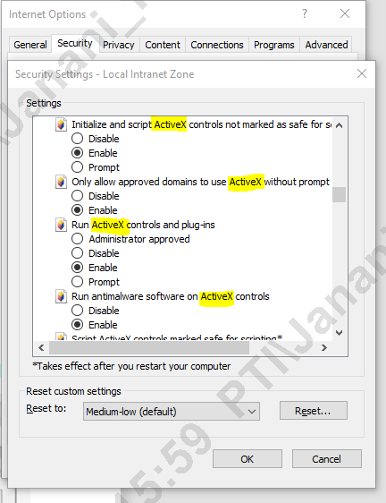
PTI| DVS Label
STEP: 2 To Make Application Work
Open Internet Explorer -> Tools -> Internet Options -> Security -> Custom Level
1. Open as per Screenshot
2. After Clicking Custom Level, security settings page gets open
Note : Ensure all ActiveX options must be enabled
(Without Enabling the ActiveX, application cann’t be opened.)
Finally click OK to apply those settings

Slide 6
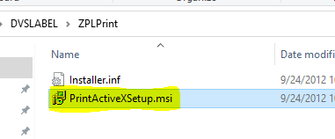
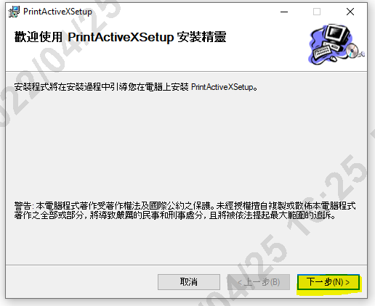
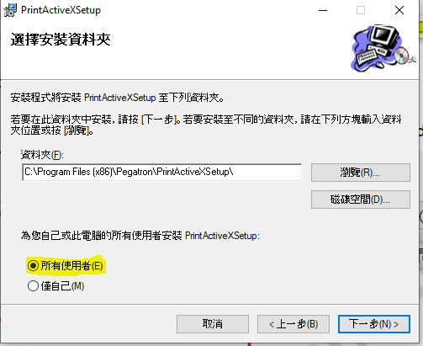
PTI| DVS Label
STEP: 3 Install PrintActiveXSetup Application for users
1
2
3
Must select the highlighted options, this represents Installing for All.

Slide 7
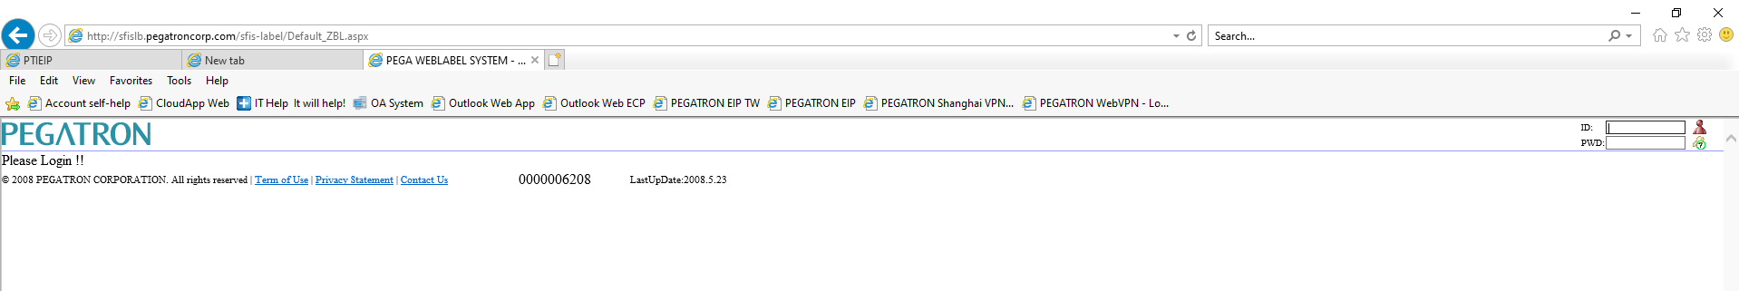
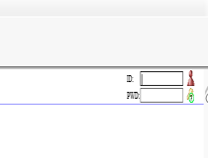
PTI| DVS Label
Shopfloor Activities : How to Print label
the User can print label using the mentioned Link
Link : http://sfislb.pegatroncorp.com/sfis-label/Default_ZBL.aspx
Once Link is clicked a page get opens
This Page permission will be provided only by IE Team

Slide 8
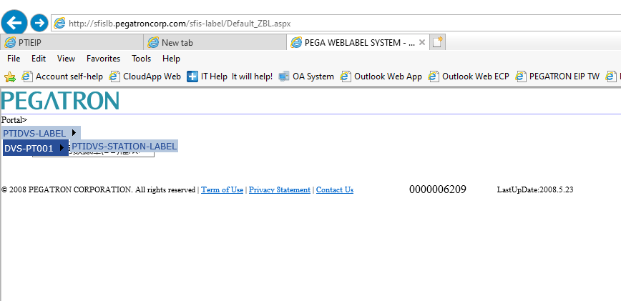
PTI| DVS Label
Once the access provided need to login the Page
By using
ID : D2XXXXXXXX
PWD : pega
After page get opened, Click PTIDVS-Label -> DVS-PT001 -> PTIDVS-STATION-LABEL

Slide 9
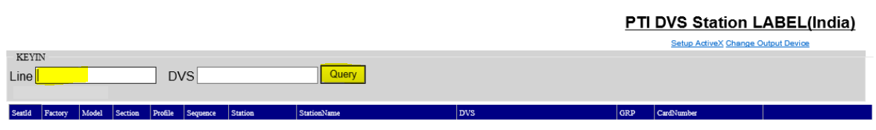
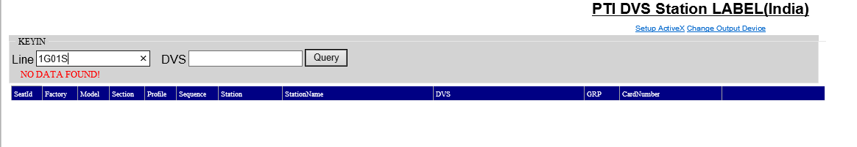
PTI| DVS Label
This DVS label will be displayed in all lines
* Enter the Line Name in the Line column and press Query
* If Data Not found than the concern team need to contact IE team(will be maintained by IE team)

Slide 10
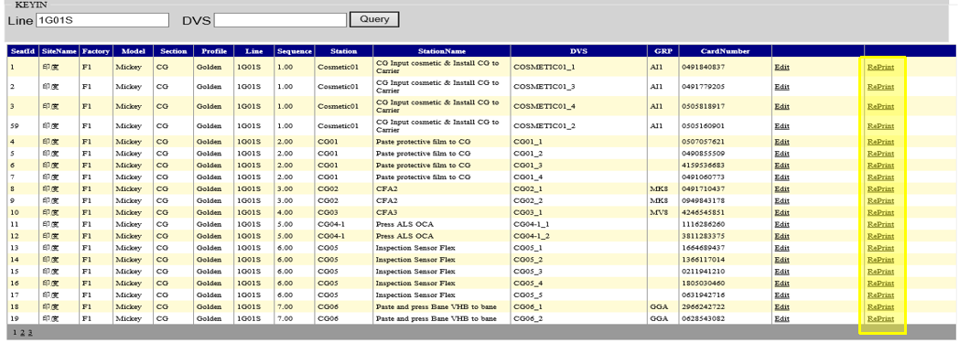
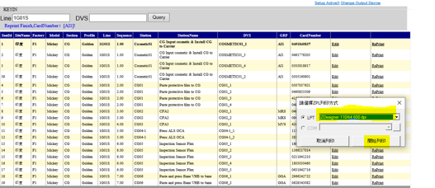
PTI| DVS Label
If datas available it gets drop down, Click Reprint for the station to which label to be printed
Connect the PC or Laptop to the printer and click Reprint, if below mentioned dialogue box get poped up than select the printer name and click OK

Slide 11
PTI| DVS Label
Roles of MIS-SFIS in this DVS Label :
1. Need to install NETFrame 2, NETFrame 4.5 & PrintActiveXSetup Applications
2. All Activex Options should be enabled (Refer Slide 5)
3. If the shopfloor people raise the query that data is empty in DVS Station label Page, than SFIS team need to Inform them to check with IE team
Note : For more queries need to contact the TAIPEI IT team
((Cami Chen(陳冠如_Pegatron) <Cami_Chen@pegatroncorp.com>))

Slide 12


